Slide 1
DHIC Testing Strategy May 2018

Slide 2
Table of content
Executive Summary
Key Consideration
QA Framework
QA Framework Details
Test Phases
Test & Defect management
Deliverables
Roles & Reponsibilities
2

Slide 3
DHIC – R1 SCOPE ITEMS
Planned Item
Requirement Complete
Build Complete
This Sprint
3

Slide 4
Demo topics
Status and key accomplishments
Installation Demo
Diagram – updated
Login to Server
Empty OOTB report
Data Specifications
Spec document
Dev story
Status – 1 Pager

Slide 5
Guidelines for DoD
Themes | Definition of Done | Deliverables
Installation User stories | Stable working environment Users are able to access and work on the environment | Environment Availability Landscape documentation
Requirements User stories | Requirements are documented and peer reviewed Signed-off by SMEs | Source to target mapping Sheet Support documentation (if applicable)
Development Stories | Code unit tested and peer reviewed Checked in to version control repository | Code Package + Extract Files Unit Testing Log
QA Stories | Test cases reviewed with BA and Development team All test cases passed/deferred | Test Cases Test case Execution Log Defect Log
5

Slide 6
Sprints 1-6 – story level
Sprint | BA Stories |  | Dev QA Stories
Sprint 1 | Customer Account Coverage Premium - CA | MIS Records Layout DHIC Installation - Dev Agency
Sprint 2 | Agent Form Policy Party Named Insured | Bi-Temporal Analysis Premium - GL DHIC Installation – Test Modifier | Agency
Sprint 3 | Address Policy Location | Policy Status Modifier – GL | Customer Account Coverage
Sprint 4 | Conformed Extract Reference Extract Premium Acc Date | MIS Stat - 1-40 - CA MIS Stat - 1-40 – GL | Party Address Form Policy Party | Policy Premium Incrmtl Changes Premium Transactions
Sprint 5 | Audit Information Location Modifier | Premium Incrmtl Changes Named Individual - CA MIS Stat 41-70 - GL MIS Stat 41-70 – CA | GL Premium Trans MIS Stat 1-40 - GL MIS Stat 1-40 - CA Agent
Sprint 6 | Condition Term - CA Coverage Term - CA Jurisdiction - CA Modifier - CA Modifier Rate Factor - CA | Policy Line - CA Vehicle - CA GL Interim Audits Premium Balancing GL | Audit Info Named Insured Policy Status GL Interim Audits | MIS Stat - 41-50 - GL MIS Stat - 51-60 - GL MIS Stat - 41-50 - CA MIS Stat - 51-60 - CA
6

Slide 7
APPENDIX
Conceptual Sprint Plan Delivery view
Delivery Stages and Other deliverables
OASIS R1 Timeline
7

Slide 8
Conceptual sprint plan delivery Timeline
Not Exhaustive
List Of Key Entities
Planned Sprint | 1 | 2 | 3 | 4 | 5 | 6 | 7 | 8 | 9 | 10 | 11 | 12
BA Stories |  |  |  |  |  |  |  |  |  |  |  | Contingency Sprint
BA Stories Timeline
Dev QA Stories
Dev QA Stories Timeline
InfoCenter Extensions
Integrated testing
Entity | #
Customer Account | 1A
Coverage | 1B
Premium - CA | 1C
Agency | 1D
MIS Records Layout | 1E
DHIC Installation - Dev | 1F
Agent | 2A
Form | 2B
Policy | 2C
Bi-Temporal Analysis | 2D
Premium - GL | 2E
DHIC Installation - Test | 2F
Party | 3A
Address | 3B
Named Insured | 3C
Location | 3D
Modifier | 3E
Policy Status | 3F
Modifier - GL | 3G
Conformed | 4A
Reference | 4B
Premuim Acc Date | 4C
Agent | 5A
Audit Information | 5B
Location | 5C
Modifier | 5D
Premium Inc. Changes | 5E
Named Individual - CA | 5F
Condition Term - CA | 6A
Coverage Term - CA | 6B
Jurisdiction - CA | 6C
Modifier - CA | 6D
Entity | #
Modifier Rate Factor-CA | 6E
Policy Line - CA | 6F
Vehicle - CA | 6G
GL Interim Audits | 6H
Premium Balancing GL | 6I
Class Code - CA | 7A
Audit - CA | 7B
Additional Interest - CA | 7C
Dealer - CA | 7D
Driver - CA | 7E
Exclusion Term - CA | 7F
Garage Service - CA | 7G
Scheduled Item - CA | 7H
Audit - GL | 8A
Class Code - GL | 8B
Condition Term - GL | 8C
Coverage Part - GL | 8D
Coverage Term - GL | 8E
Exclusion Term - GL | 8F
Exposure - GL | 8G
Rate Factor - GL | 8H
Policy Line - GL | 8I
Condition - GL | 8J
Exclusion - GL | 8K
Conformed - CA | 9A
Reference - CA | 9B
Conformed - GL | 9C
Reference - GL | 9D
MIS Stat Feed Build 1 | 10A
MIS Stat Feed Build 2 | 10B
EARS/Verisc Feed | 11
Extensions | 11
8K
6I
8I
8J
3G
6G
6H
7G
7H
8G
8H
1E
1F
2E
2F
3E
3F
5E
5F
6E
6F
7E
7F
8E
8F
1C
1D
2C
2D
3C
3D
4C
5C
5D
6C
6D
7C
7D
8C
8D
9C
9D
1A
1B
2A
2B
3A
3B
4A
4B
5A
5B
6A
6B
7A
7B
8A
8B
9A
9B
10A
10B
8I
8J
6G
7G
8G
3G
7F
5F
8E
8H
9C
11
3B
5E
6I
6E
6F
7E
7H
8F
8K
7B
11
1D
2C
3A
3D
3E
5B
6H
6C
6D
7C
7D
8C
8D
9A
9D
1A
2B
1C
2B
2A
2E
3C
3F
6A
6B
7A
7B
8A
8B
4A
4B
8

Slide 9
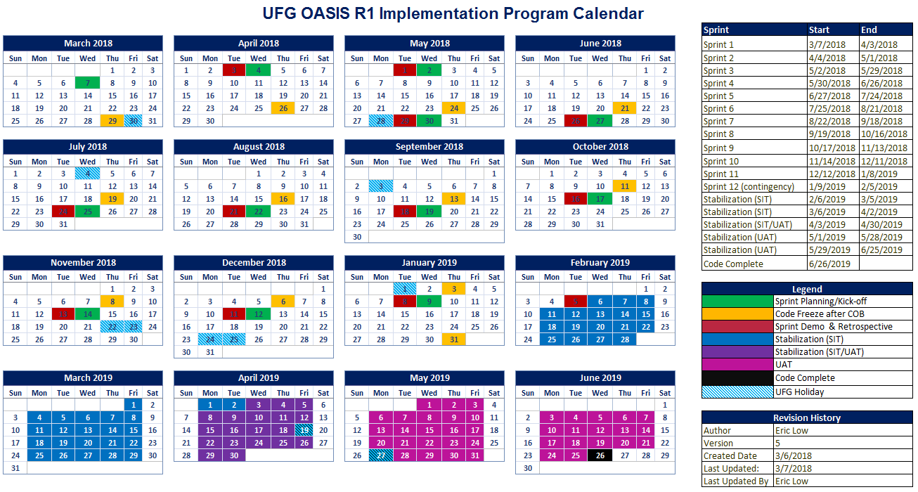

Slide 10
Delivery stages
Phase | Activities | Deliverables
Infrastructure | Initial Setup Dev, test, UAT Install Datahub/IC tools SAP BODS, Cognos Setup Replica DB Setup extracts location | DevOps Setup Developers machine Build automation
Design | Specification creation (working sessions/offline work) Identify need and Design extension at DataHub Test planning Test cases design MIS, GL integration specifications | Solution architecture Document Detailed Design=Mapping specification xls Test cases
Development | Build Extracts Build Datahub extensions Load data in data hub Load data in Info Center Unit testing PC/BC Datahub extensions | Extract file routines Datahub customizations PC/BC integration routines enhancements
Testing | Unit testing Regression testing Business/data testing Integration testing with PC/BC/MIS/GL etc. | Automated testing routine
Stabilization | Stabilization testing UAT | Regression testing results Go-live business signoff
10

